Slide 1

How Can Predictive Analytics in Healthcare Insurance Save Money?
Lina Jichi, Manager of Health Financing Advisory and Monitoring,
Department of Health - Abu Dhabi (DOH)

Slide 2






Slide 3

Cost Saving Initiatives
Payers choose Providers with low Provider prices (multiplier) →low annual claim cost
Facilities hiring more GPs →lower Facility spend
However, they are missing the target!
Payers applying Caps on Claims → lower claim cost
Facilities asking their physicians to code → save on coders cost

Slide 4


Slide 5

For simplicity, let us narrow the discussion down to controlling health insurance claims cost
Claim cost components
1
1
Ineffective ways to reduce cost
2
2
Elements of success
3
3

Slide 6
Claim cost components
Claim Cost
Utilization
Unit Cost
(Activity price)
# of claims (Visits + follow up visits after the free 7 days)
# of the activities in each non bundled claim
Activities utilization pattern by type
Basic Price list
Multiplier
Medical Inflation
Equipment & Devices

Slide 7
We created the Financing Model to better understand the high level links among the components of the Health Financing System and produce financial projections the next 10 years . In summary:
Source
Individuals
Employers
Government
(DoF)
Inter-mediary
Insurance
Sink
Public Providers
Private Providers
Foreign Providers
.. This helps to classify which initiatives will shift the spend from one component to another vs. the initiatives that actually saves money from the total healthcare cost

Slide 8
But the provider income is based on many factors
Provider income driver tree
Utilization
Activity
  ×
Public/private Share
Product 1
Inpatient
Inpatient
  ×
Reimb’t
  +
  +
  +
Product 2
Outpatient
Payment
  +
Outpatient
Out of pocket
…
  ×
Provider
  +
  ×
Product n
Members
Members
  +
Government subsidy
  +
Other
Reimbursement = Claim net * (1- denial rate) * (1+ IBNR[Incurred but not reported])
Out of pocket = Self pay + Patient Share
Other Income = Medical Tourism in UAE + Research grants

Slide 9
Insurance premium driver tree
Gov’t*
  +
Premium
Employer
Product 1
  ×
  +
Beneficiary
Members
Insurance Premium
  +
Product 2
…
  +
Product n
* Government contribution = Basic Product Subsidy

Slide 10
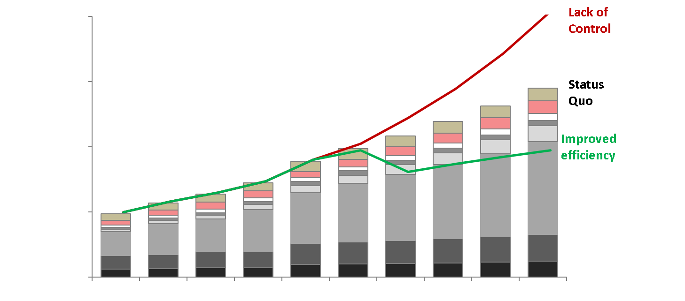
By proper modeling and detailed assumptions, future spend can be predicted more accurately accounting for the financial impact of the initiatives ,whether it is truly “improving efficiency” OR “causing lack of control”

Slide 11
Claim cost components
1
1
Ineffective ways to reduce cost
2
2
Elements of success
3
3

Slide 12
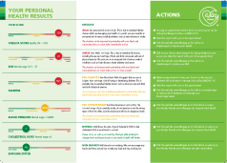
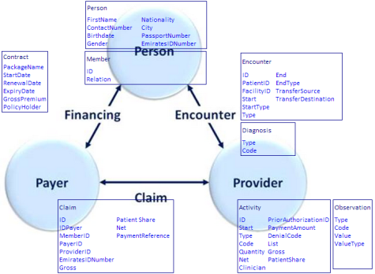

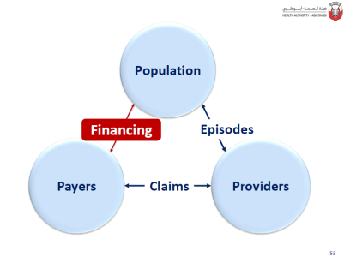
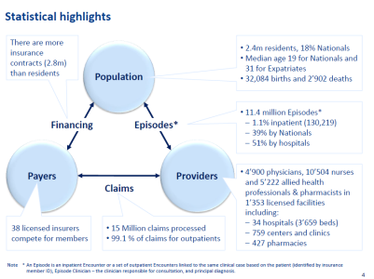
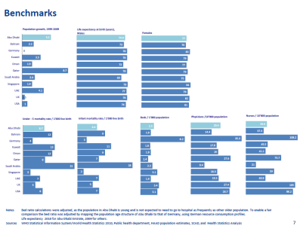
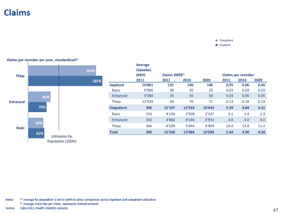
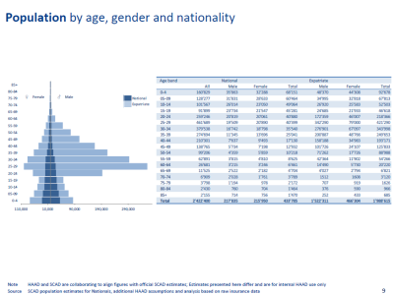
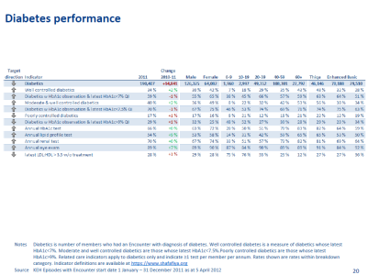
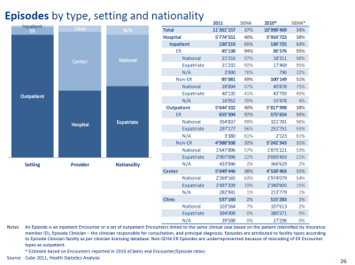
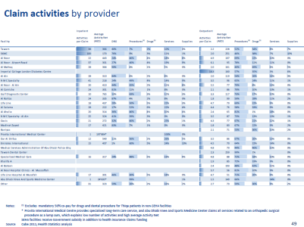
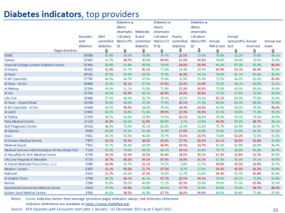
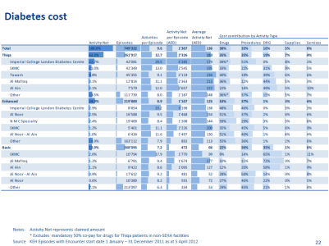
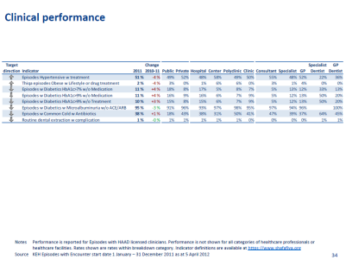
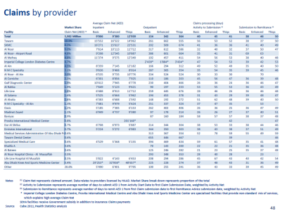
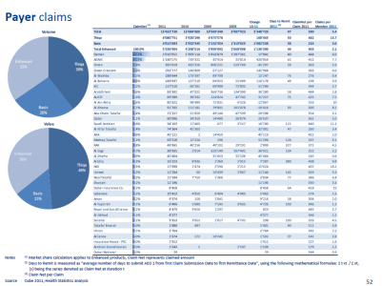
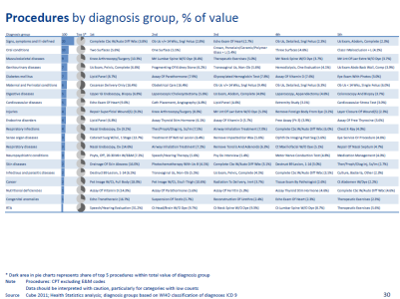
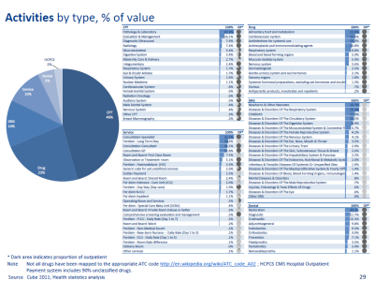
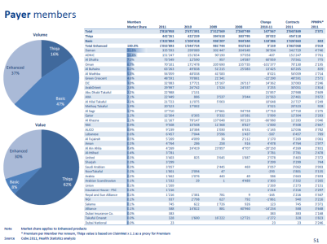
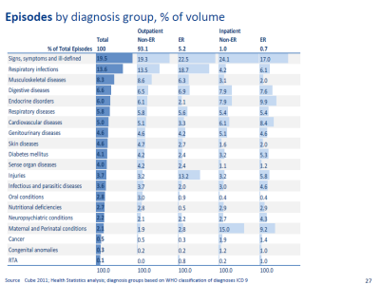
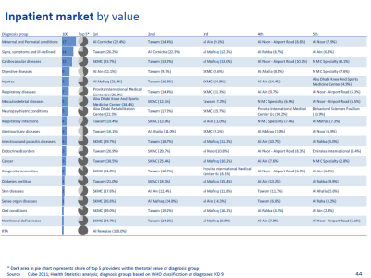
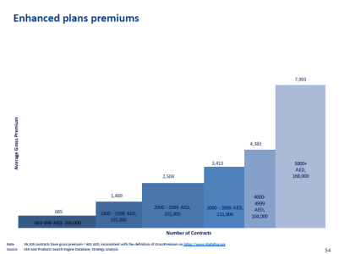
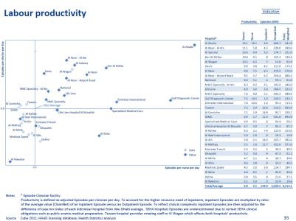
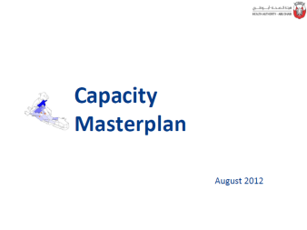
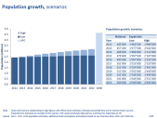
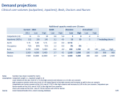
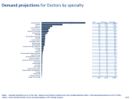
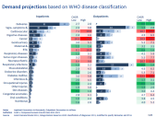
Evaluation based on local and international data
Weqaya portal
Providers
Knowledge Engine for Health DW
Payers
Data architecture
Demographics
eClaims
Pharmacy Benefits Management
eAuthorisation
ePrescribing
Routine reporting:
Strategy
Strategy
Strategy
Statistics & Modelling
HF Advisory & Monitoring
Policy & Standards
Policy
Manuals
Policy impact assessment
Policy evaluation
Professional
Providers
Insurersl
Diabetes
HbA1c
Fasting plasma glucose
Plasma glucose
Fasting triglyceride
Blood cholesterol LDL
Blood cholesterol HDL
Albumin
Microalbumin
Clinical signs
Body Height
Body Weight
Intravascular systolic
Intravascular diastolic
History of tobacco use
Breast cancer
Screening Mammography
Unlisted codes
Activity cost
Cancer
Date of Initial Encounter
Date of Initial Diagnosis
Date of Initial Treatment
Primary Site
Histology
Sequence Number
Behaviour
Grade
Laterality
Basis of Diagnosis
Clinical T, N, M
Clinical Stage Group
Pathologic T, N, M
Pathologic Stage Group
Multiplicity Counter
Marital Status
Occupation
City of Residence
Weqaya
Random glucose
HbA1c
Total cholesterol
Blood cholesterol in HDL
Total vitamin D
Serum Creatinine
Body height
Body weight
Intravascular systolic
Intravascular diastolic
Circumference at umbilicus
Circumference
100-question questionnaire:
Education
Employment
Network
Family history
Smoking
Food choice
Physical activity
Regulators
Data validation for clinical quality management system
External and internal requests
Advise to other departments
Health System Strategy Review
Financing model
DRG weights update
Compliance enforcement framework
Health System Regulation
Analysis of prescribing patterns
Enforcement of compliance
Public Health
Weqaya
CVD, Asthma analyses
Key Performance Indicators
DG office
External requests
Communications
Publications of health sector data in media
Planning & Investment
Health SystemFinancing
Audit
Enforcement
Mandatory Tariff
Key Performance Indicators
Planning applications
Capacity planning
Capacity management initiative

Slide 13
Type 1: Decrease claim cost temporarily but increase it shortly after
We classified ineffective ways to reduce claim cost
Type 2: Decrease claim cost while negatively affecting quality and/or access which lead to increasing ED or inpatient admission → higher cost in the long term
Type 3: Do not reduce claim cost and sometimes even increase it due to providers identification of some workaround to avoid revenue loss

Slide 14
Determining price based on few hospitals cost →encourages inefficiency
Ineffective ways examples
Determining a facility’s multiplier based on the facility group multiplier → more common specialty clinics will open in overserved areas (so higher utilization here) and less access in underserved (less access here will push for more ED and inpatient admissions)
Over rejecting claims → higher cost to reprocess claims and/or providers to over-utilize

Slide 15
Targeting the controls on higher unit cost services and lack of detailed analysis to identify higher utilization activities →Providers to increase over utilizing the non targeted services
Ineffective ways examples
Reducing Audits for more saving on operational cost → providers to up-code
Adopting tools and initiatives from non-compatible insurance systems without customization →unexpected consequences and unclear financial impact

Slide 16
Claim cost components
1
1
Ineffective ways to reduce cost
2
2
Elements of success
3
3

Slide 17
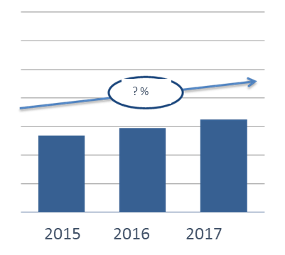
Elements of success
To really believe that you need to save on cost
Each claim cost reduction initiative to be evaluated from the 3 angles: access, quality, and cost, and evaluation should be over the short term and long term
Finally, most sustainable claim cost control initiatives for payers are the initiatives that encourage providers cost efficiency too, so when a provider have a lower cost of a total service, he will be less likely to resist a small total service price reduction, such as DRGs and homecare bundled services- so bundling while monitoring and rewarding positive outcomes are the keys to ensure financial efficiency and sustainability
1. Encounter Type:
Inpatient,
Outpatient,
Emergency
2. Member group:
Basic,
Enhanced,
Thiqa
3. Providers :
Public,
Private,
Abroad
4. Diagnosis Group:
Respiratory,
Circulatory,
Digestive, …
5. Increase reason :
Population Increase,
Utilization change,
Price Inflation

Slide 18
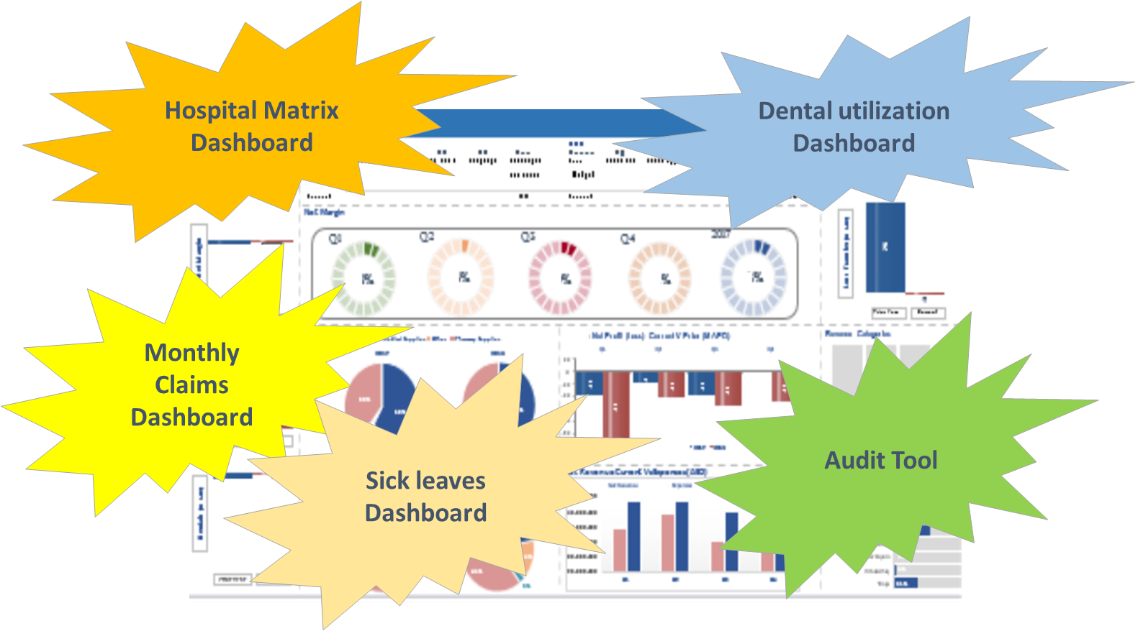
Data Analytics can also be used in monitoring utilization and financial sustainability on a daily basis

Slide 20
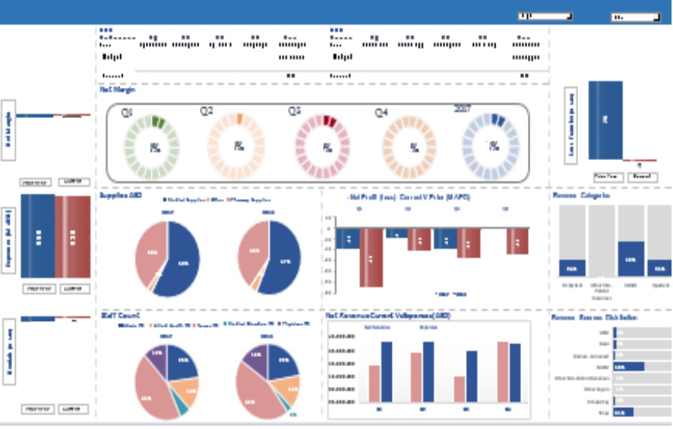
Where to start? If you have not done so already, we recommend having a detailed dashboard by count and dirham amount of the most granular level of data points available and identifying your actual cost, historical trends and projections:
Payers
Product#
Main Policyholder
Facility
Service line
Inpatient
Outpatient
Service type
Quality & Financial KPIs
Providers
Facility #
Service line
Doctor
Nurses
Inpatient
Outpatient
Labs
Pharma
Quality & Financial KPIs

Slide 21
Questions?

